Slide 1
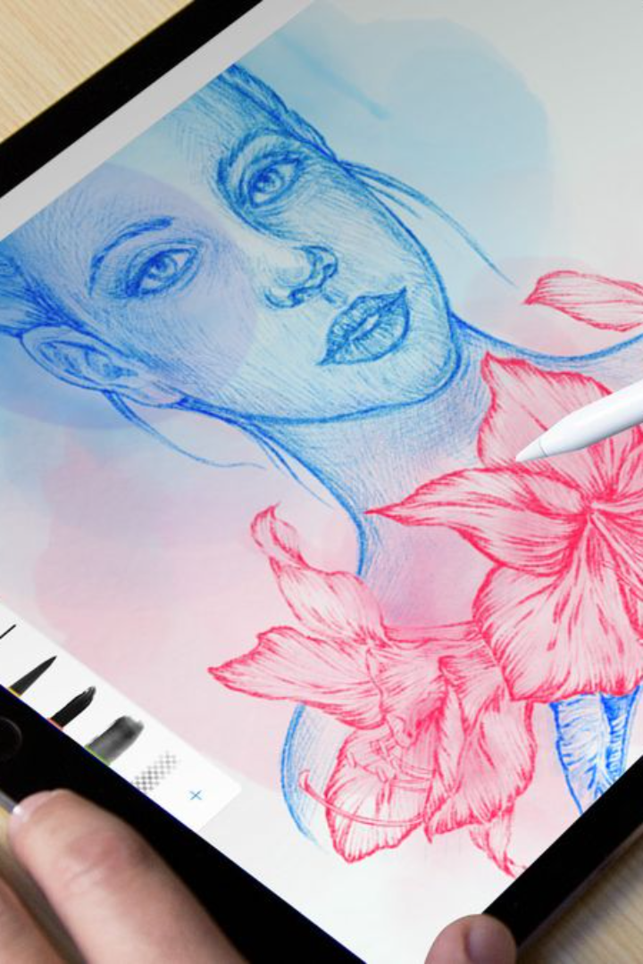
Introduction to the Makeup Artist Booking Web Application
A platform designed to seamlessly connect proficient makeup artists with clients, providing a convenient and reliable way to access top-tier beauty services.
pitch deck by IGIRIMPUHWE Dositha

Slide 2
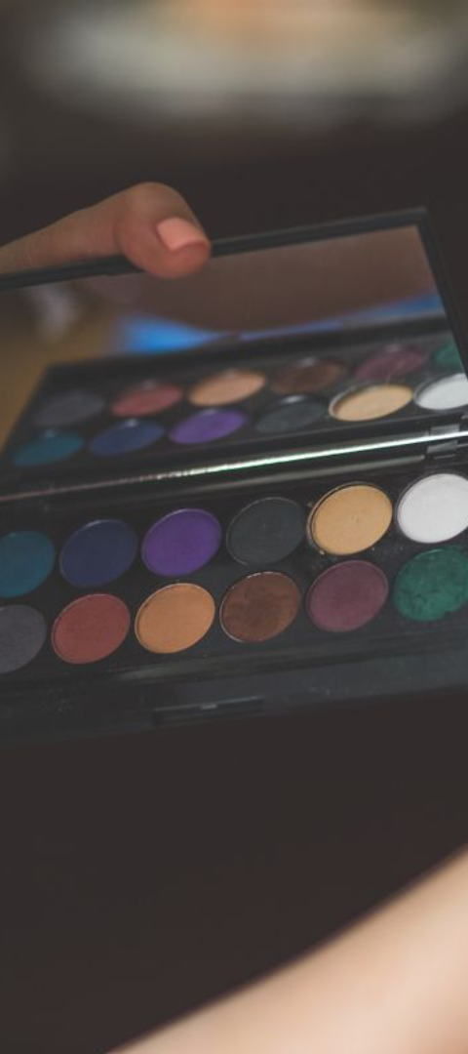



How the Web Application Works
User Registration
Both makeup artists and clients create profiles, providing necessary details for identification.
Advanced Search Capabilities
Clients can search based on location, expertise, and availability while makeup artists can view client preferences.
Seamless Booking Process
Clients can directly book makeup artists based on availability and confirmed rates.

Slide 3
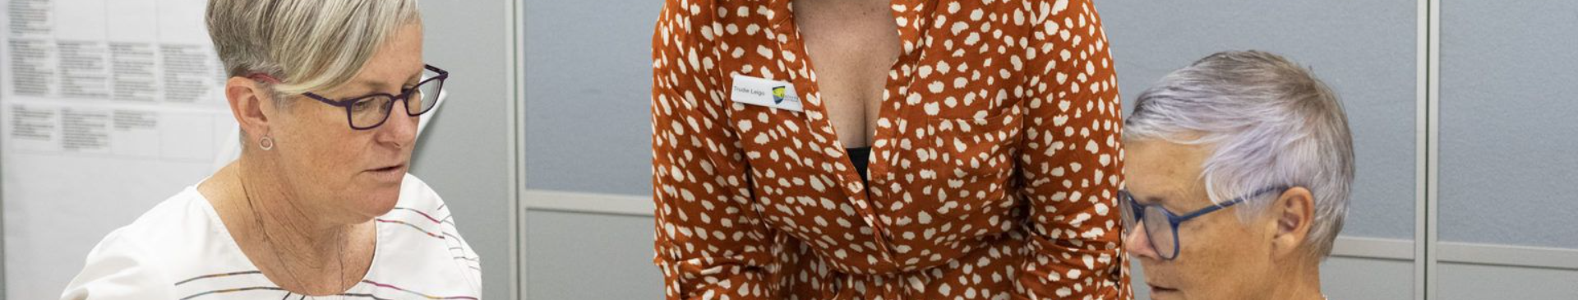
Features and Benefits for Makeup Artists
1
Increased Visibility
2
Convenient Payment
3
Client Rating and Reviews
Secure payment processing, ensuring timely and accurate compensation for services.
Exposure to a wider clientele base and promotion of skills and expertise.
Feedback mechanism to enhance reputation and attract new clients.

Slide 4
How to Create a Profile as a Makeup Artist
Profile Information
Service Offerings
Portfolio Showcase
Add details such as qualifications, experience, and portfolio images.
Specify services provided, rates, and availability for potential clients.
Upload high-quality images of past work to create an appealing portfolio.

Slide 5
How to Search and Book a Makeup Artist as a Client
Search Criteria
Artist Profiles
Booking Process
Use filters to find artists based on location, specialty, and availability.
Browse through profile details, check ratings, and assess portfolios to make informed decisions.
Select a suitable time slot and complete the booking securely through the app.

Slide 6
Payment and Rating System
Secure Transactions
Rating Mechanism
Automatic Payments
Protected payment channels to ensure the safety of both parties involved.
Clients can provide feedback and ratings to maintain quality standards.
Streamlined system for hassle-free and prompt compensation to artists.

Slide 7
Conclusion and Next Steps
1
Feedback Loop
Gather user feedback for continuous improvement based on user experiences.
2
Expansion and Outreach
Explore opportunities for expanding services to different regions and demographics.
3
Collaborations and Partnerships
Form partnerships with beauty brands and influencers to enhance the platform's reach.

